Slide 1
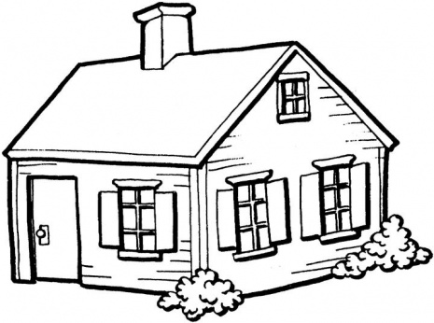
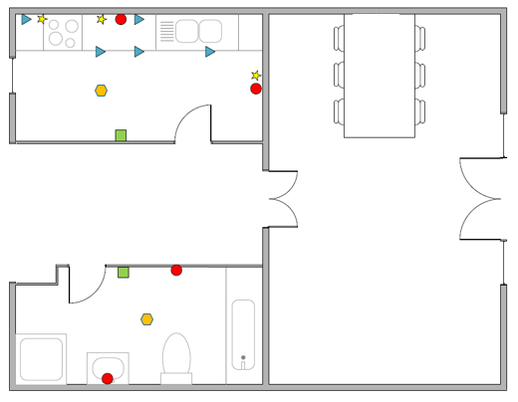
Household Activities Dataset
People's daily activities inside the house
Sensors deployed and monitor events
Kitchen
Bathroom
Collected the data for various activities

Slide 2
Household Activities Dataset Description
Collected data for the following activities:
Continence
Personal Hygiene
Showering
Food Preparation
Other activity in kitchen
Other activity in bathroom
In addition, we annotated all these activity

Slide 3
Household Activities Dataset Description
Set up
1 person household
5 types of sensors
18 sensors
Around 5 full days of recording
117 annotations
6321 events

Slide 4
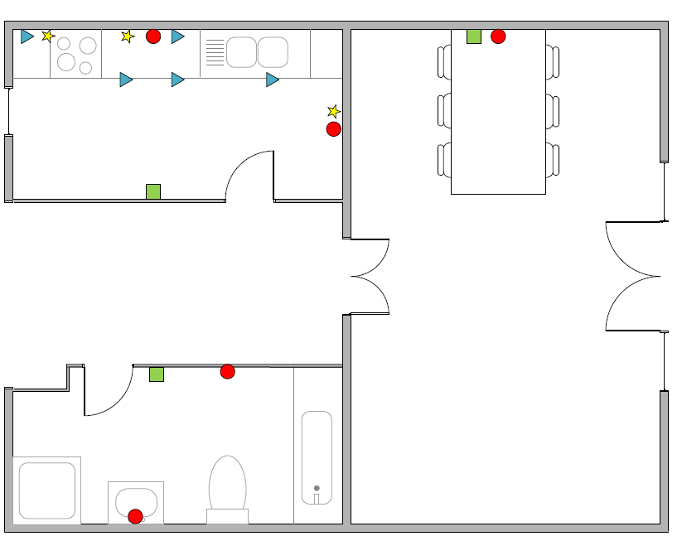
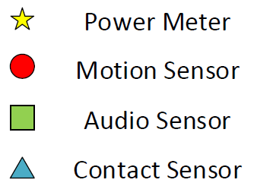
Floor plan
Location Sensor

Slide 5
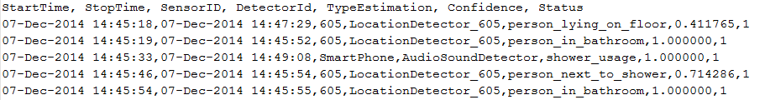
Events
Each sensor produces events. Structure:
Start Time
Stop Time
Sensor ID
Detector ID
Type Estimation
Confidence level
Status flag
All events from all sensors are located in the file events.csv
Example

Slide 6
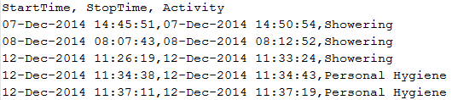
Annotations
Annotations are done manually by a human to produce groundtruth
Annotations are done for activities e.g. from x to y ‘Food preparation’ was happening
Format:
Start Time
Stop Time
Activity
All annotations for all activities are located in the file annotation.csv
Example

Slide 7
How annotations relate to events. Example
Continence

Slide 8
How annotations relate to events. Example
Food Preparation

